Slide 1

DBA5103
Operations Research and Analytics
Zhenyu Hu
Semester I, 2026/2027

Slide 2
Software Implementation

Slide 3
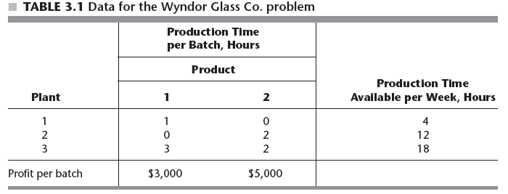
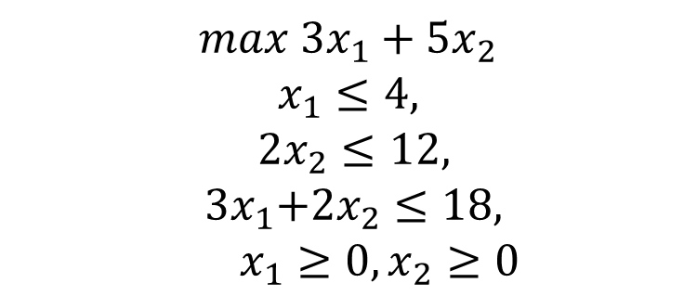
Wyndor Glass Co.
$$max{ 3x}_{1}+{5x}_{2}$$
$$x_{1}≤4,$$
$$2x_{2}≤12,$$
$${ 3x}_{1}+{2x}_{2}≤18,$$
$x_{1}≥0,x_{2}≥0$

Slide 4
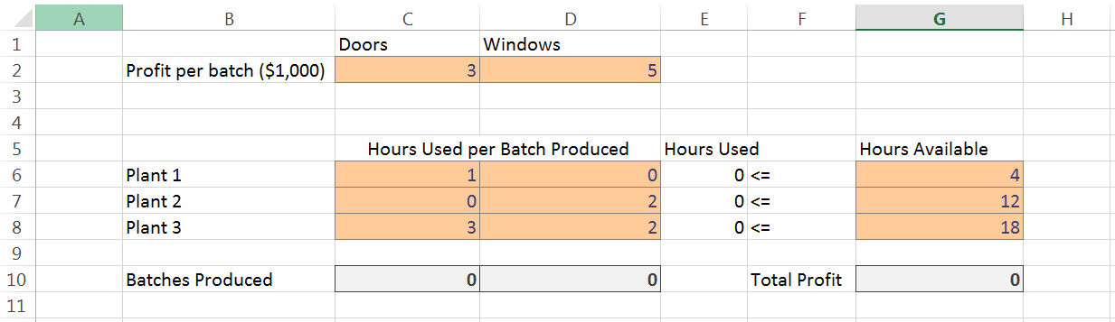
Model in Solver

Slide 5
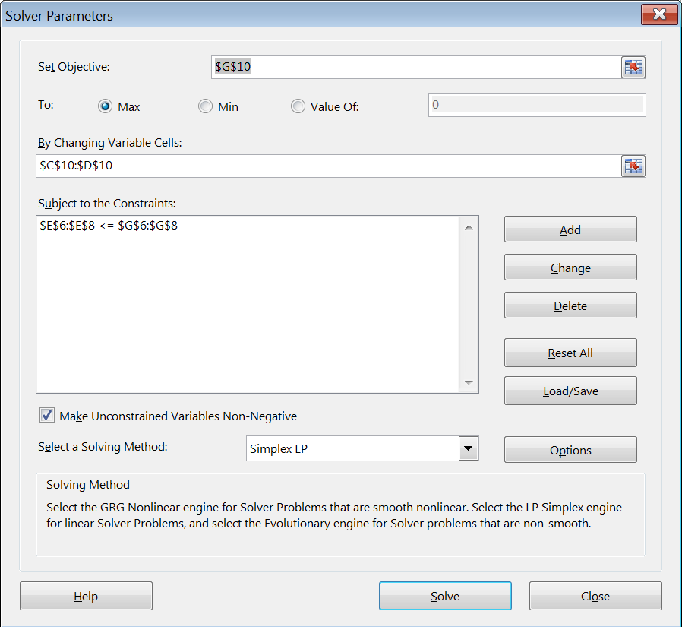
Model in Solver

Slide 6
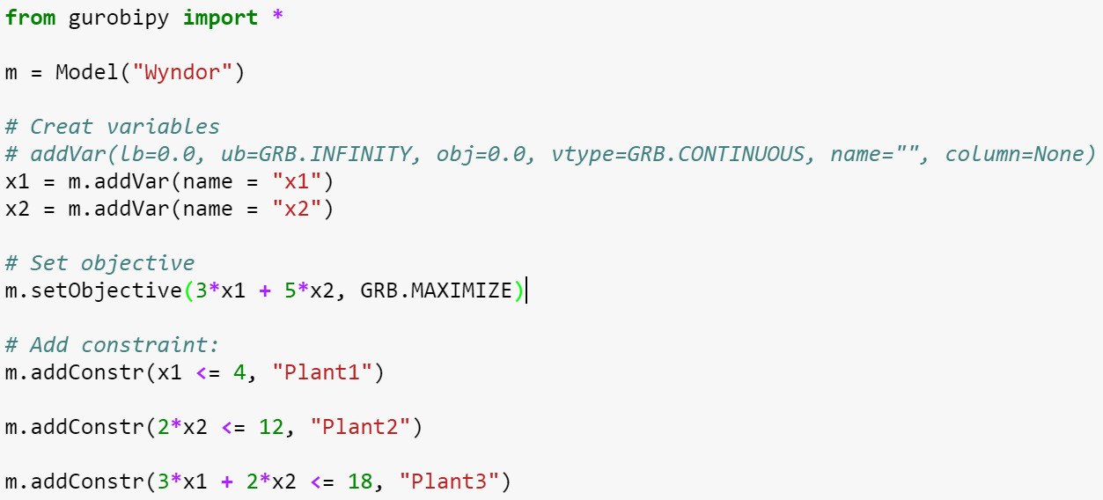
Model in Gurobi

Slide 7
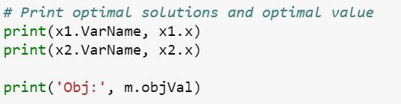
Solving the Model and Display Output
Solving the model
Display solution and optimal value

Slide 8
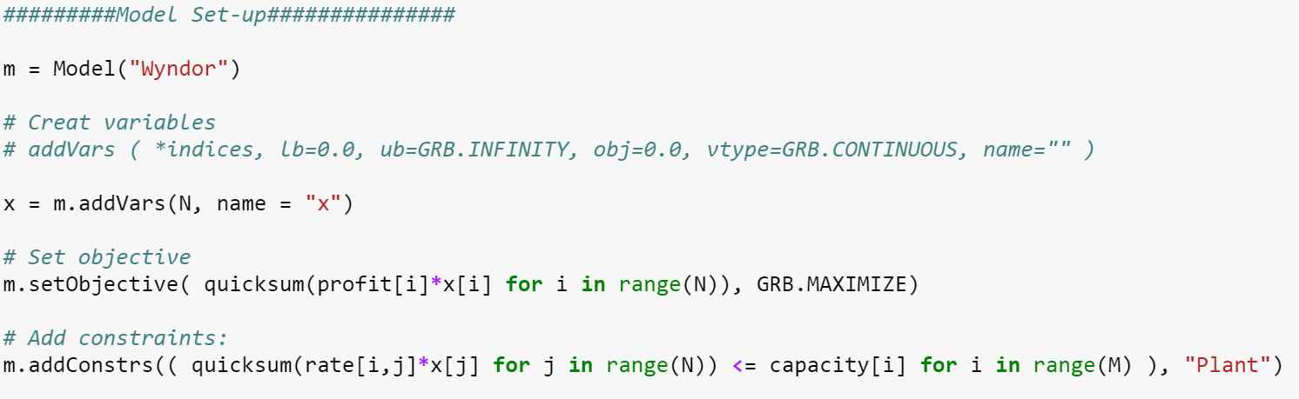
Separating Model and Data: Model

Slide 9
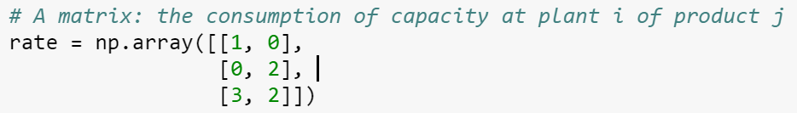
Separating Model and Data: Data

Slide 10
Geometry of Linear Programming

Slide 11
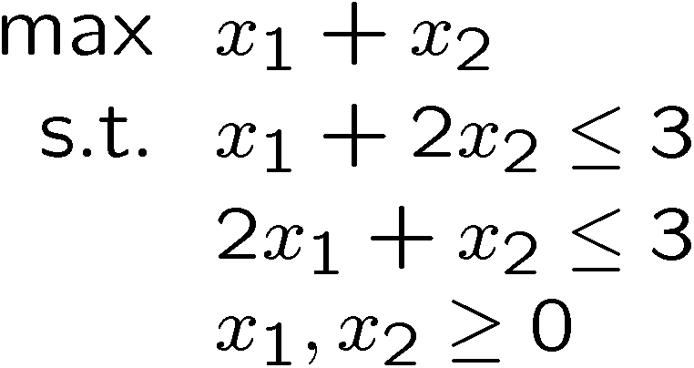
Geometry of LP in 2D
Objective: maximize x₁ + x₂
X₂
x₁ + x₂ = 0
0
X₁

Slide 12
Geometry of LP in 2D
Feasible Region: The set of all the allowed solutions; a polyhedron described by the constraints
  Each equality constraint defines a line
  Each inequality constraint defines a half-space
Extreme Points (Corner-Point Feasible Solution): Corner points on the boundary of the feasible region. E.g., (0, 0), (1.5, 0), (0, 1.5), and (1, 1)
Infeasible problem: A problem with an empty feasible region
X₂
0
X₁

Slide 13
Geometry of LP in 2D
Optimal Solution: The best feasible solution
For any feasible LP with a finite optimal solution, there exists an optimal solution that is an extreme point
X₂
Max x₁ + x₂
Optimal Solution:
(1, 1)
0
X₁
x₁ + x₂ = 2

Slide 14
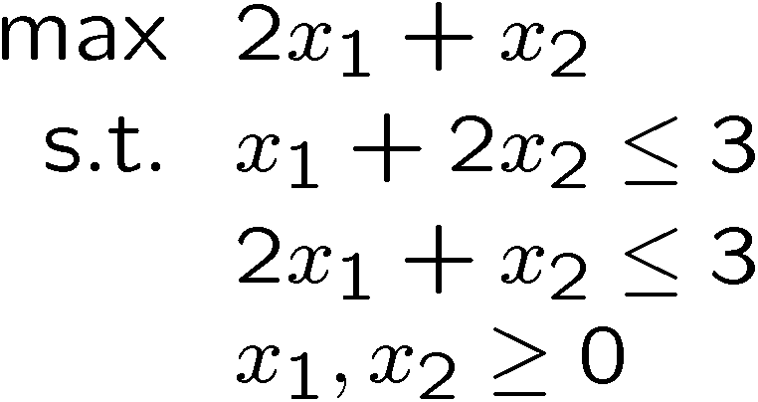
Geometry of LP in 2D
Optimal solutions may NOT be unique
X₂
Max 2x₁ + x₂
0
X₁

Slide 15
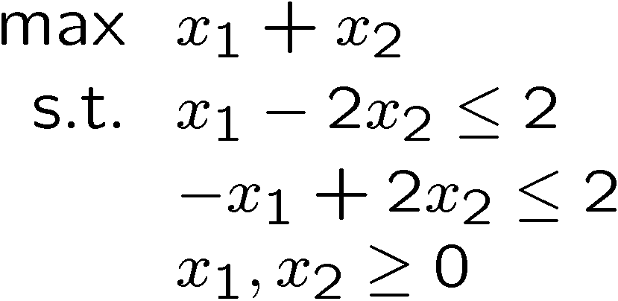
Geometry of LP in 2D
Optimal solution may NOT be finite
-X₁ + 2X₂ ≤ 2
X₂
Max x₁ + x₂
X₁ - 2X₂ ≤ 2
(0, 1)
0
(2, 0)
X₁

Slide 16
Summary
Solutions of LP
  Unique optimal solution
  Multiple optimal solutions
  The optimal objective is not bounded
  Infeasible
Sufficient to focus on extreme point
  How to describe extreme point in high dimension?

Slide 17
Active/Binding Constraints
Binding (or active) constraints: The constraints that are satisfied at equality for a given solution
  All equality constraints (if satisfied) are binding
Non-binding (or inactive) constraints are satisfied at strict inequality for a given solution
The inequality level is known as the slack
  Binding constraints have zero slack by definition

Slide 18
Back to Extreme Point
(0, 3)
Constraints | Binding? | Slack
X₁ + 2X₂ ≤ 3 | Yes | 0
2X₁ + X₂ ≤ 3 | Yes | 0
X₁ ≥ 0 | No | 1
X₂ ≥ 0 | No | 1
(0, 1.5)
(1, 1)
(0, 0)
(1.5, 0)
How many binding constraints will an extreme point have?
What if we add constraints $x_{2}≤1.5$ and ${2x}_{1}≥0$? Think about (0,1).
What about (0,3)?
Notes:
(0, 1.5), (0, 1), (0, 3)

Slide 19
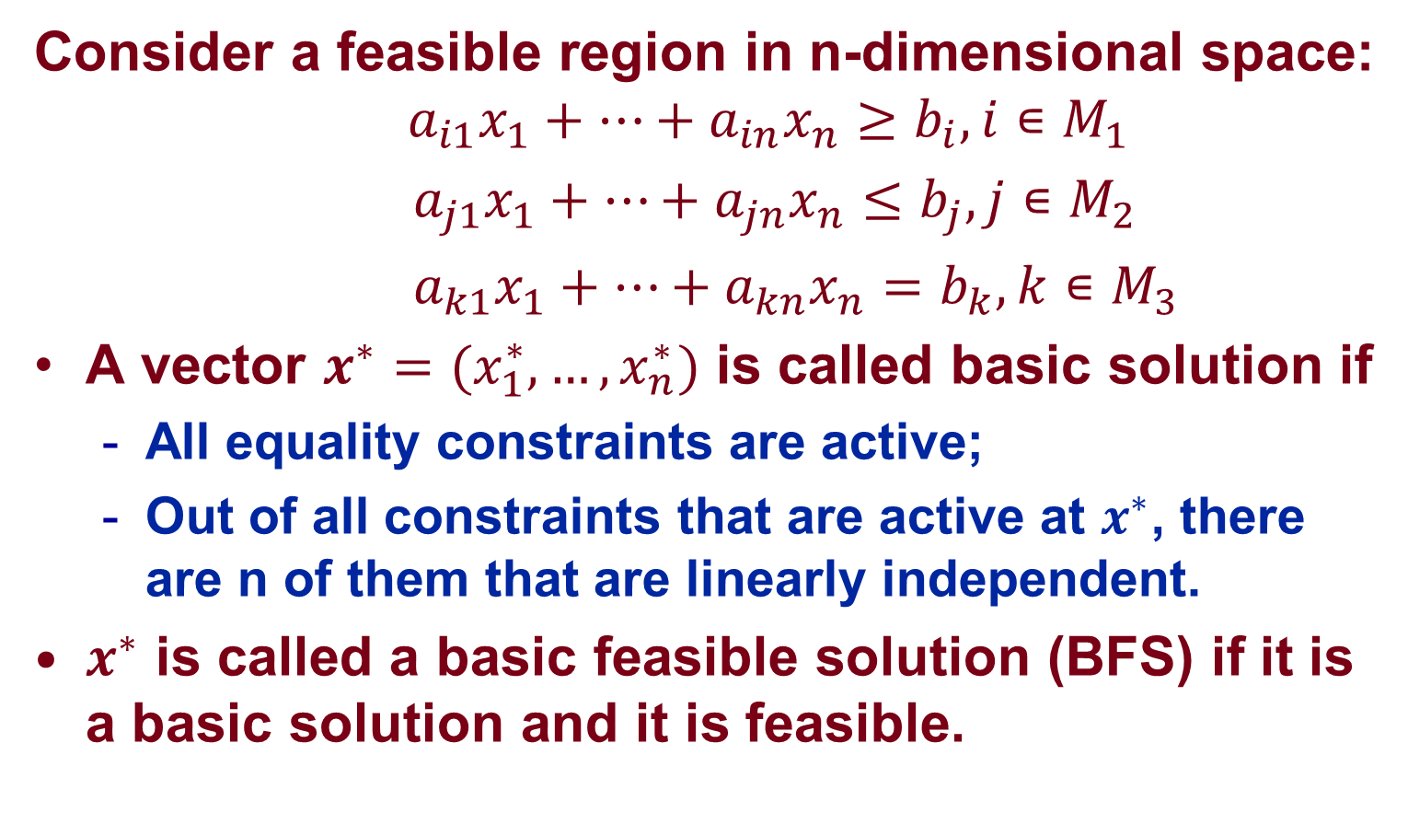
Extreme Point: An Algebraic Perspective
Consider a feasible region in n-dimensional space:
$${ a}_{i1}x_{1}+…+a_{in}x_{n}≥b_{i}, i∊M_{1}$$
${ a}_{j1}x_{1}+…+a_{jn}x_{n}≤b_{j}, j∊M_{2}$
${ a}_{k1}x_{1}+…+a_{kn}x_{n}=b_{k}, k∊M_{3}$
A vector $x^{∗}={(x}_{1}^{∗},…,x_{n}^{∗})$ is called basic solution if
  All equality constraints are active;
  Out of all constraints that are active at $x^{∗}$, there are n of them that are linearly independent.
$x^{∗}$ is called a basic feasible solution (BFS) if it is a basic solution and it is feasible.
Polyhedron:
BFS = Extreme Point

Slide 20
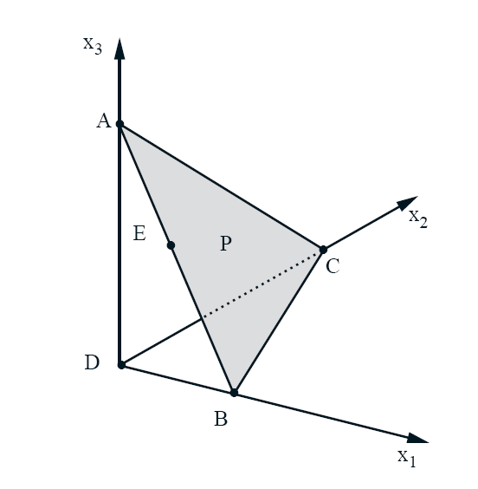
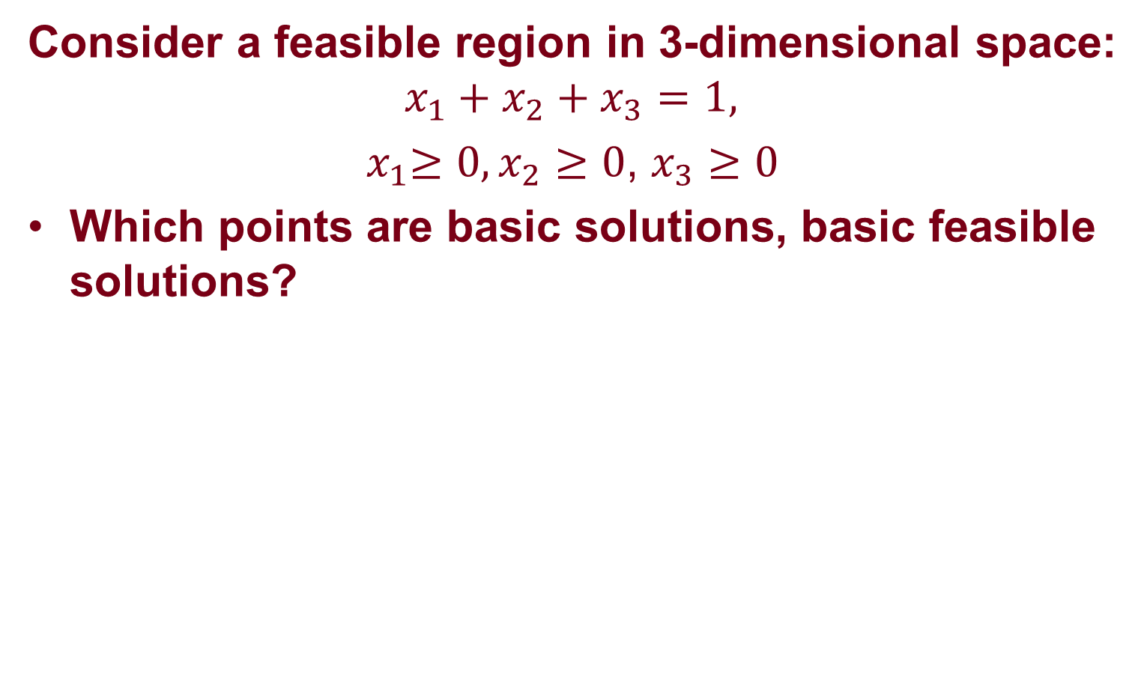
3-D Example
Consider a feasible region in 3-dimensional space:
$$x_{1}+x_{2}+x_{3}=1,$$
${ x}_{1}≥0,x_{2}≥0$, $x_{3}≥0$
Which points are basic solutions, basic feasible solutions?

Slide 21
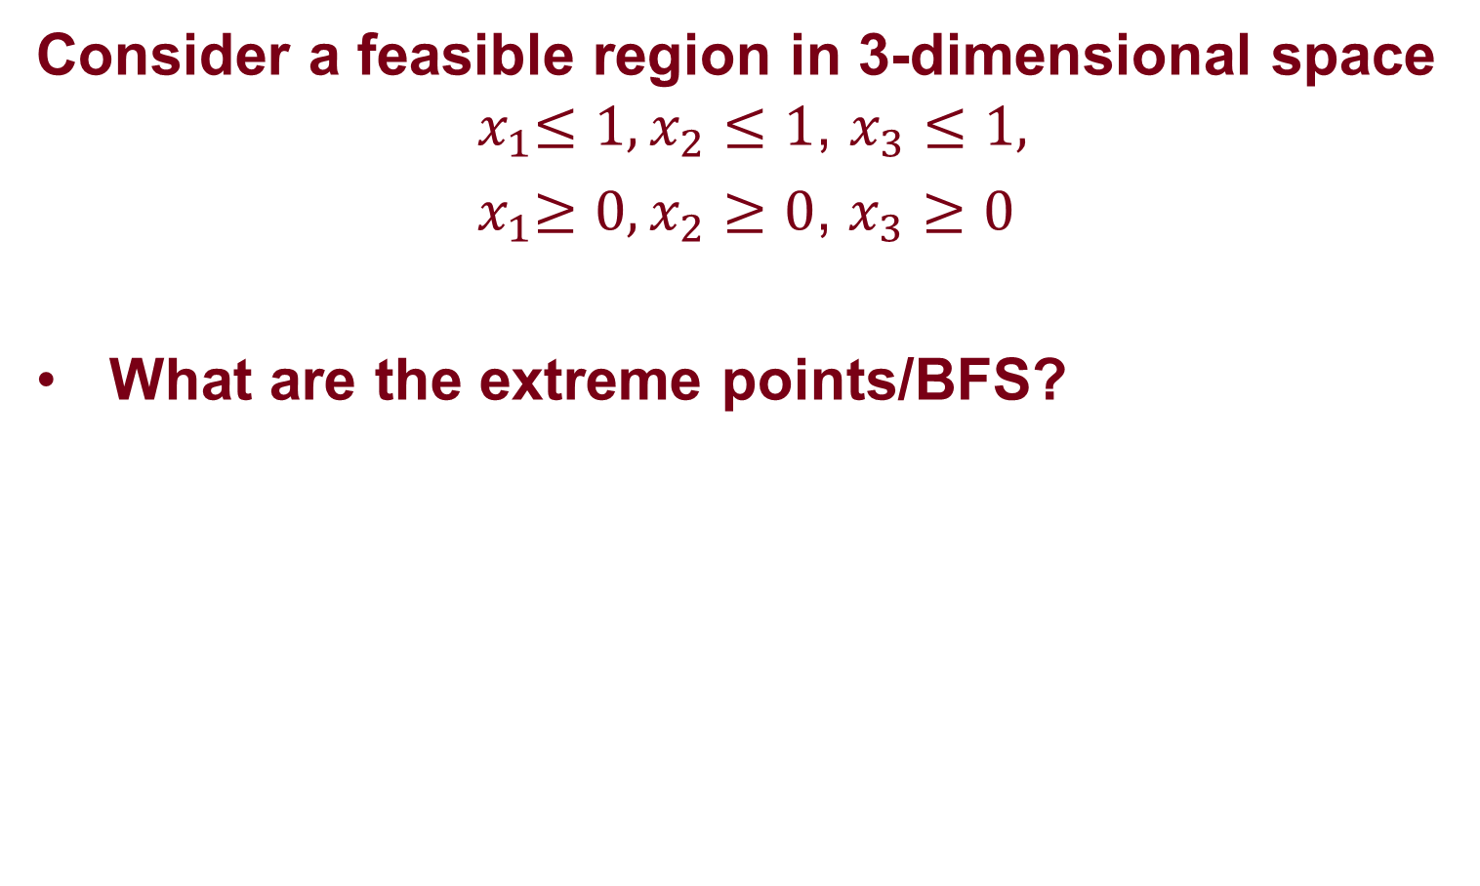
3-D Example
Consider a feasible region in 3-dimensional space ${ x}_{1}≤1,x_{2}≤1\text{, }x_{3}≤1,$
${ x}_{1}≥0,x_{2}≥0$, $x_{3}≥0$
What are the extreme points/BFS?

Slide 22

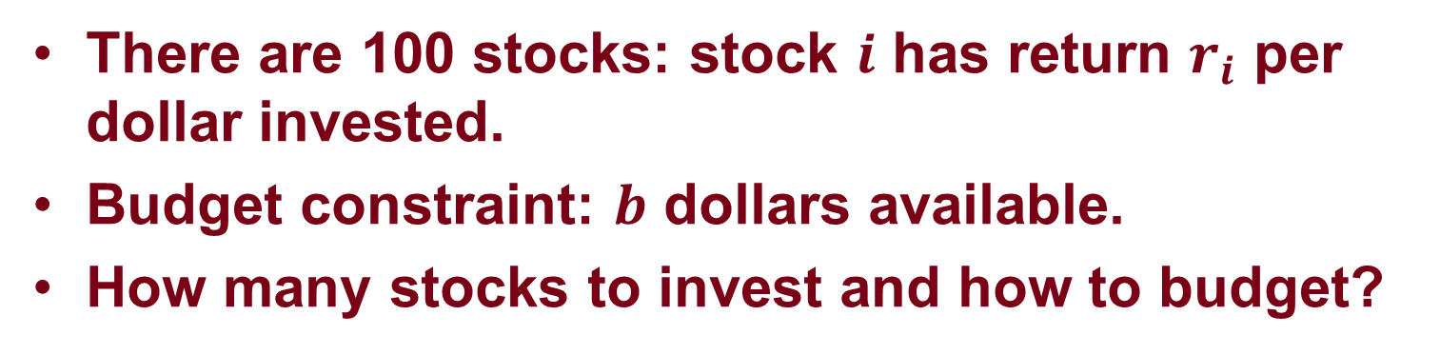
Insights: Portfolio Management Problem
There are 100 stocks: stock $i$ has return $r_{i}$ per dollar invested.
Budget constraint: $b$ dollars available.
How many stocks to invest and how to budget?
$max r_{1}x_{1}+…+r_{100}x_{100}$
$s.t. x_{1}+…+x_{100}≤b,$
${ x}_{1} ≥0, …,x_{100}≥0$

Slide 23

Insights: Portfolio Management Problem
Suppose the stocks 1-10 are the top 10% riskiest stocks and at most half of the budget can be allocated to these stocks.
How many stocks to invest and how to budget?
$max r_{1}x_{1}+…+r_{100}x_{100}$
$s.t. x_{1}+…+x_{100}≤b,$
$x_{1}+…+x_{10}≤b/2$,
${ x}_{1} ≥0, …,x_{100}≥0$

Slide 24
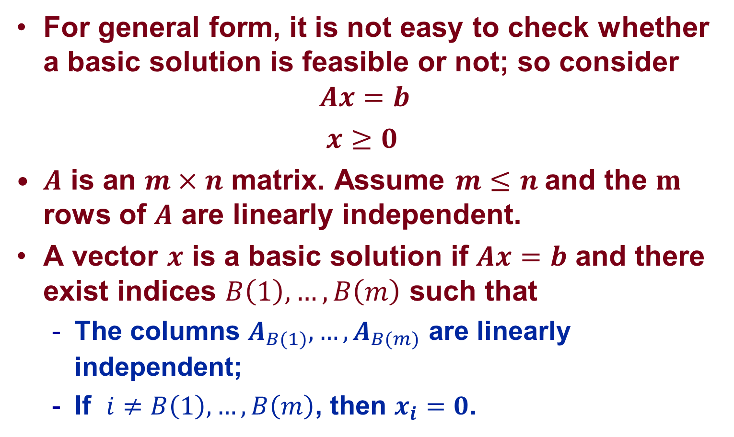
Extreme Point in Standard Form
For general form, it is not easy to check whether a basic solution is feasible or not; so consider
$$Ax=b$$
$x≥0$
$A$ is an $m×n$ matrix. Assume $m≤n$ and the $m$ rows of $A$ are linearly independent.
A vector $x$ is a basic solution if $Ax=b$ and there exist indices $B\left(1\right),…,B\left(m\right)$ such that
  The columns $A_{B(1)},…,A_{B(m)}$ are linearly independent;
  If $i≠B\left(1\right),…,B\left(m\right)$, then $x_{i}=0$.
Notes:
x_1A_1 + x_2A_2 + … + x_nA_n = b

Slide 25
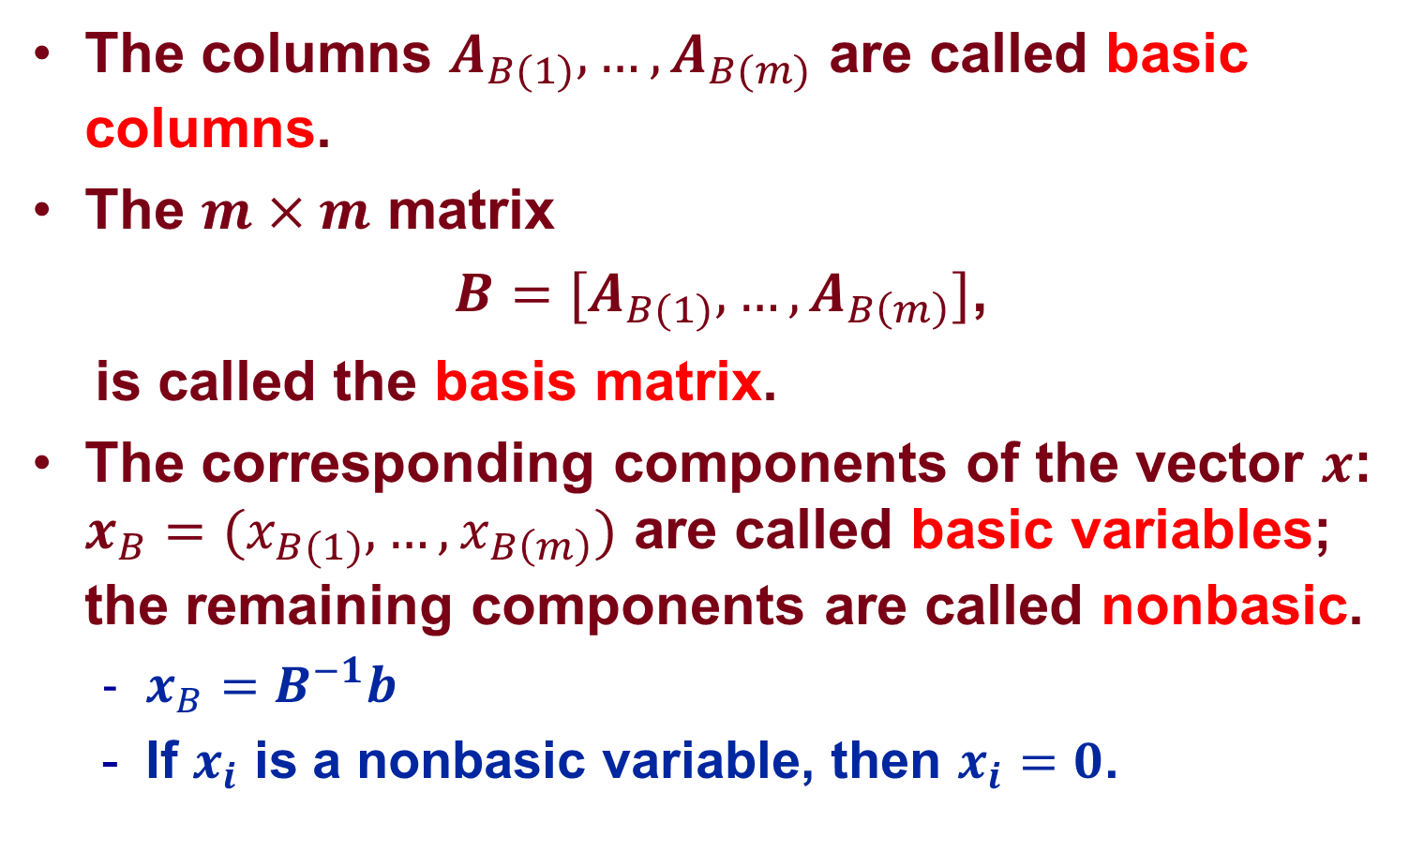
Some Terminology
The columns $A_{B(1)},…,A_{B(m)}$ are called basic columns.
The $m×m$ matrix
${B=[A}_{B(1)},…,A_{B\left(m\right)}]$,
is called the basis matrix.
The corresponding components of the vector $x$: ${x_{B}=(x}_{B(1)},…,x_{B\left(m\right)})$ are called basic variables; the remaining components are called nonbasic.
  $x_{B}=B^{−1}b$
  If $x_{i}$ is a nonbasic variable, then $x_{i}=0$.

Slide 26
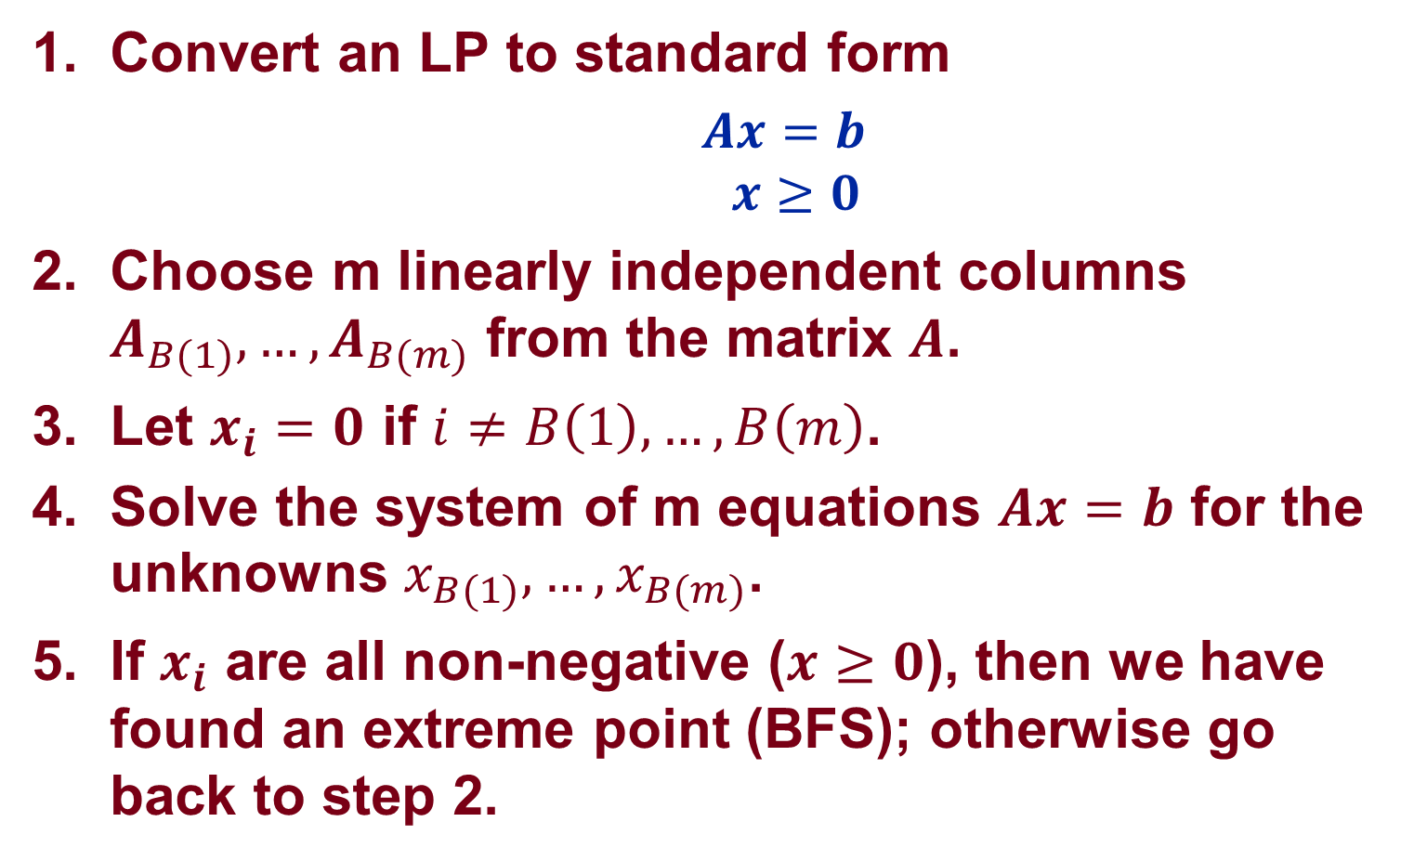
An algorithm to find extreme point
Convert an LP to standard form
  $Ax=b$ $x≥0$
Choose m linearly independent columns $A_{B(1)},…,A_{B(m)}$ from the matrix $A$.
Let $x_{i}=0$ if $i≠B\left(1\right),…,B\left(m\right)$.
Solve the system of m equations $Ax=b$ for the unknowns $x_{B(1)},…,x_{B(m)}$.
If $x_{i}$ are all non-negative ($x≥0$), then we have found an extreme point (BFS); otherwise go back to step 2.

Slide 27
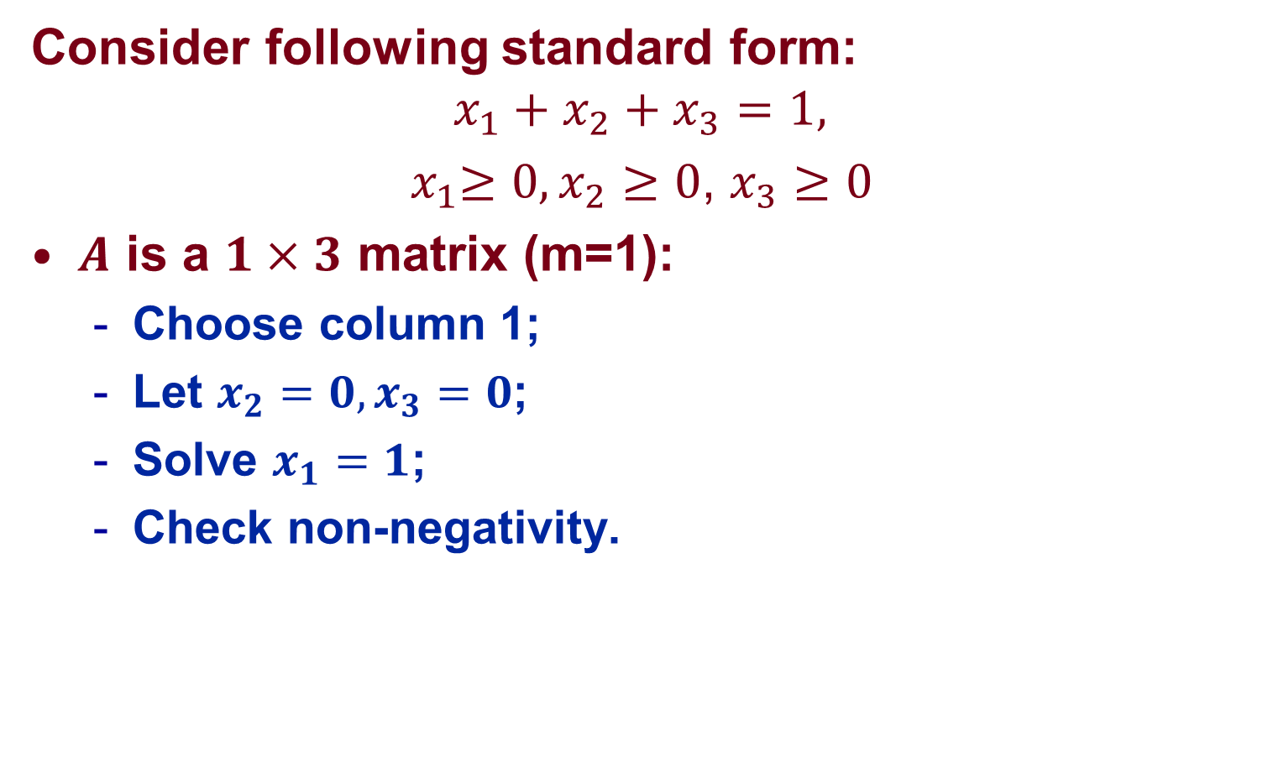
Example
Consider following standard form:
$$x_{1}+x_{2}+x_{3}=1,$$
${ x}_{1}≥0,x_{2}≥0$, $x_{3}≥0$
$A$ is a $1×3$ matrix (m=1):
  Choose column 1;
  Let $x_{2}=0,x_{3}=0$;
  Solve $x_{1}=1$;
  Check non-negativity.

Slide 28
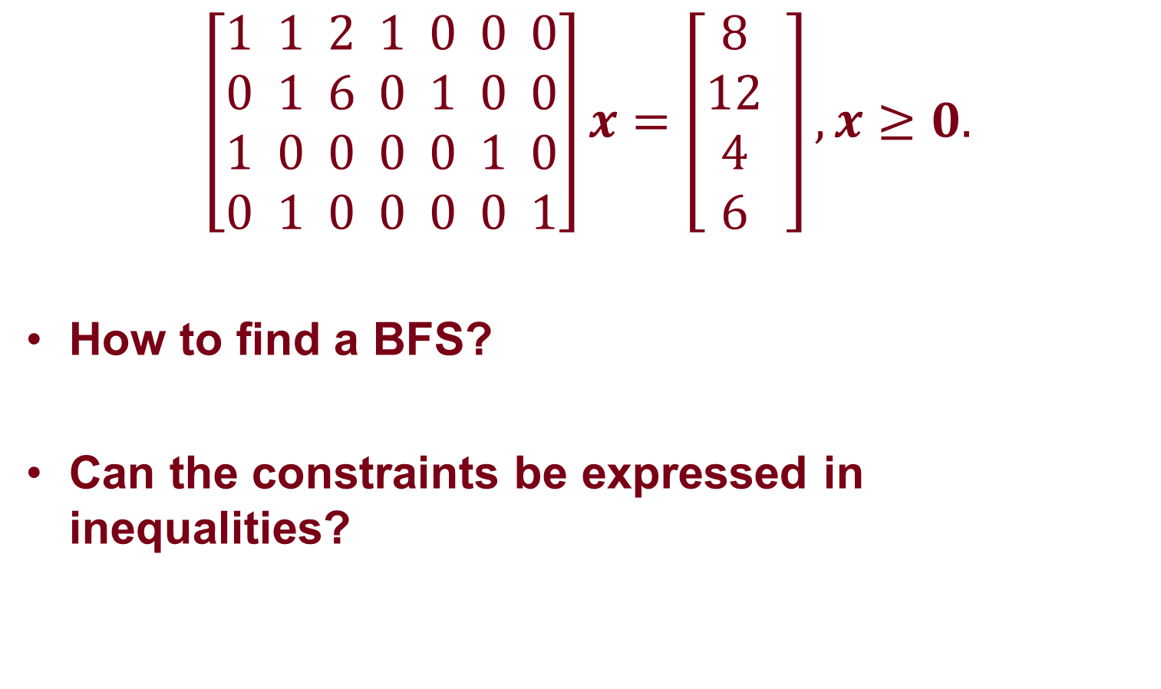
Example
$$\left[\begin{aligned}1 1 2 1 0 0 0 \\ 0 1 6 0 1 0 0 \\ 1 0 0 0 0 1 0 \\ 0 1 0 0 0 0 1\end{aligned}\right]x=\left[\begin{aligned}8 \\ 12 \\ 4 \\ 6 \end{aligned}\right],x≥0.$$
How to find a BFS?
Can the constraints be expressed in inequalities?
Notes:
(0, 0, 0, 8, 12, 4, 6)

Slide 29
Summary
Each basic solution has m basic variables
  Rest of variables are nonbasic variables and are set to zero
Values of basic variables given by:
  Solution to a system of m equations
A basic feasible solution (BFS)
  Basic solution where all m basic variables are nonnegative

Slide 30
Simplex Method

Slide 31
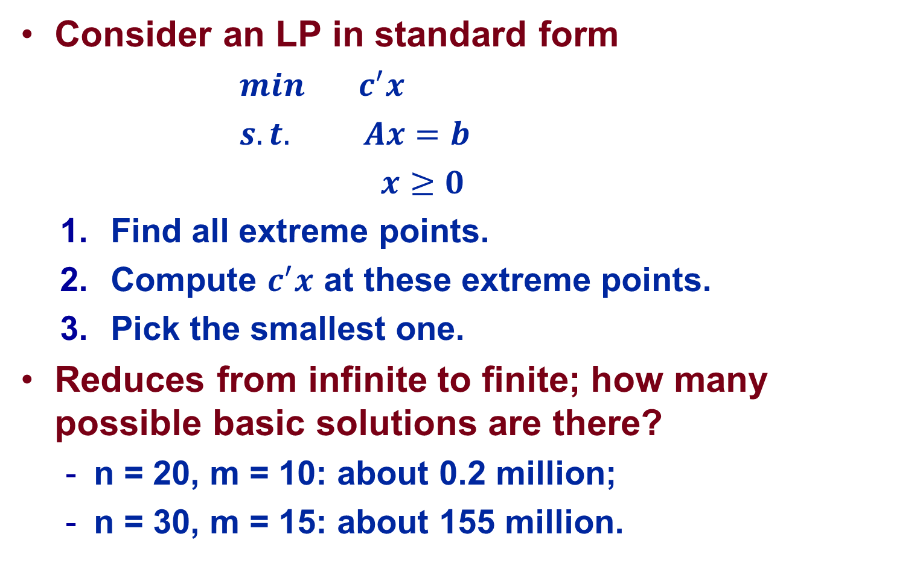
Naïve Approach
Consider an LP in standard form
  $min c^{′}x$
  $s.t. Ax=b$
  $x≥0$
  Find all extreme points.
  Compute $c^{′}x$ at these extreme points.
  Pick the smallest one.
Reduces from infinite to finite; how many possible basic solutions are there?
  n = 20, m = 10: about 0.2 million;
  n = 30, m = 15: about 155 million.

Slide 32
A General Idea
Find a feasible solution;
Determine whether the current solution is optimal or not: optimality condition.
  If yes, terminate; else proceed to step 3.
Search the neighborhood of the current solution to find another feasible solution with lower cost, and go back to step 2.

Slide 33
Optimality Condition
Why is (0, 0) not optimal?
Why is (1, 1) optimal?
(0, 1.5)
(1, 1)
(0, 0)
(1.5, 0)
Max x₁ + x₂

Slide 34
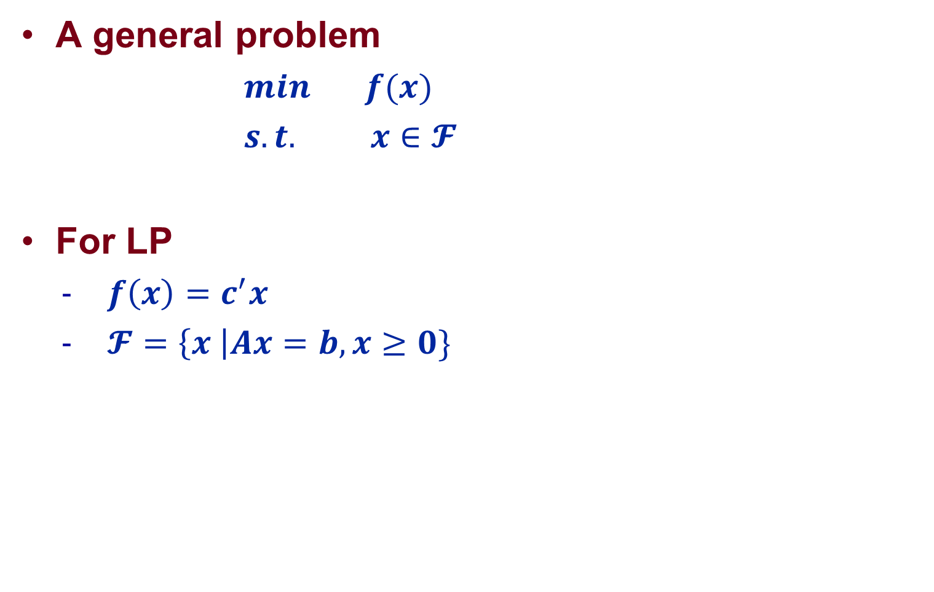
A General Optimization Problem
A general problem
  $min f(x)$
  $s.t. x∈𝓕$
For LP
  $f\left(x\right)=c^{′}x$
  $𝓕=\left\{x \right|Ax=b,x≥0\}$

Slide 35

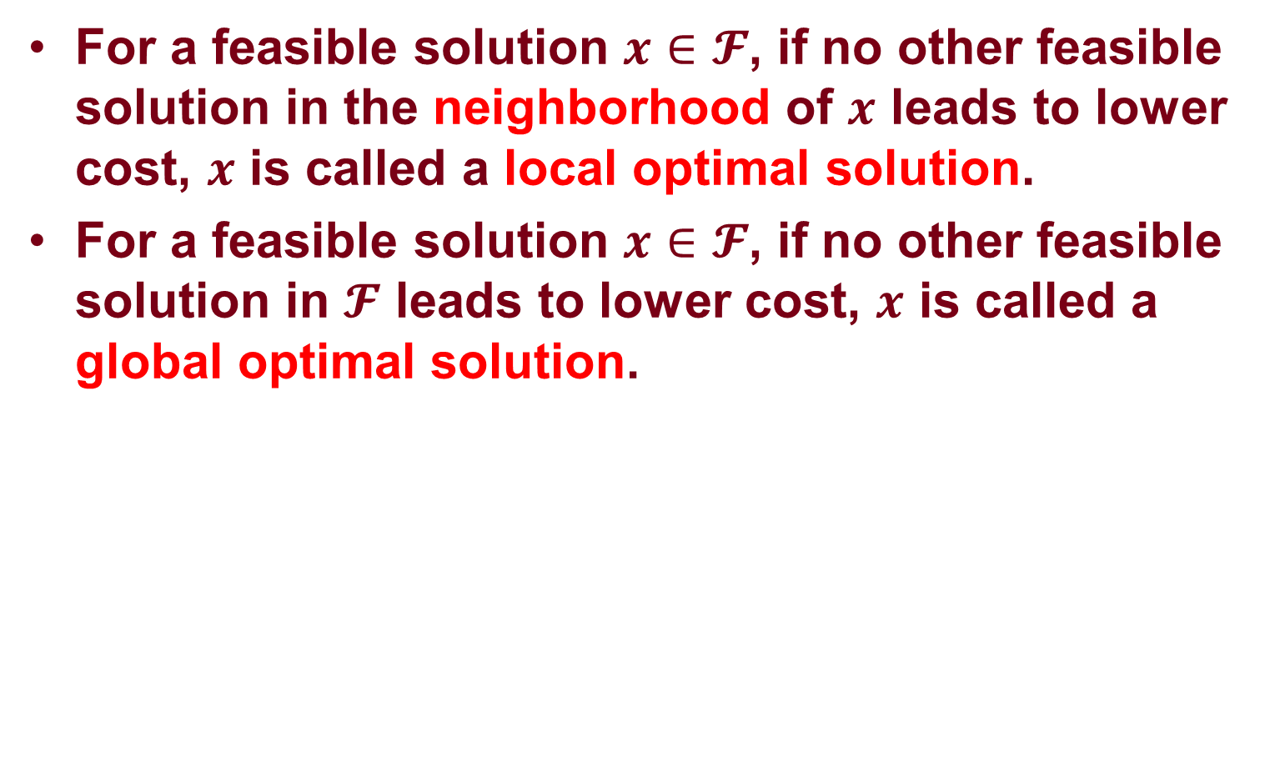
Local Optimality vs Global Optimality
For a feasible solution $x∈𝓕$, if no other feasible solution in the neighborhood of $x$ leads to lower cost, $x$ is called a local optimal solution.
For a feasible solution $x∈𝓕$, if no other feasible solution in $𝓕$ leads to lower cost, $x$ is called a global optimal solution.

Slide 36
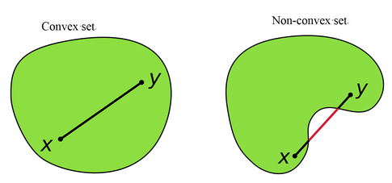
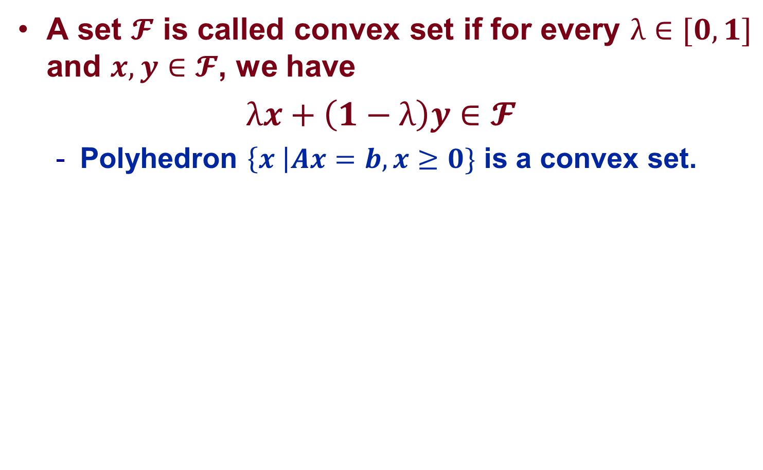
Convex Set and Convex Function
A set $𝓕$ is called convex set if for every $λ∈[0, 1]$ and $x,y∈𝓕$, we have
$λx+\left(1−λ\right)y$ $∈𝓕$
  Polyhedron $\left\{x \right|Ax=b,x≥0\}$ is a convex set.

Slide 37
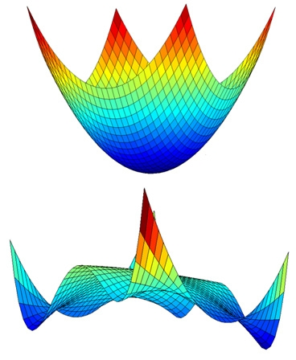
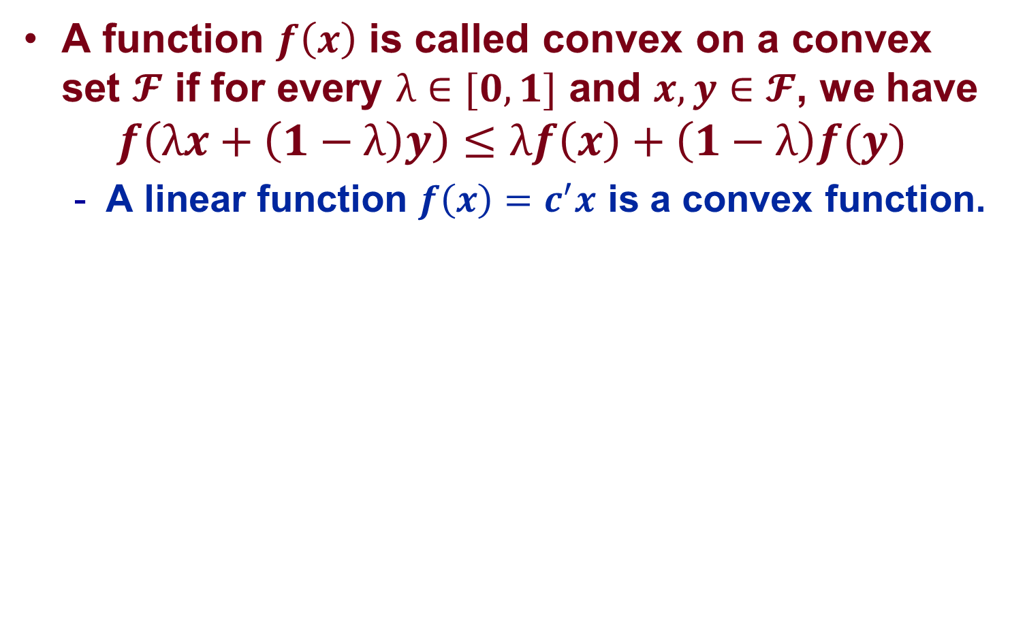
Convex Set and Convex Function
A function $f\left(x\right)$ is called convex on a convex set $𝓕$ if for every $λ∈[0, 1]$ and $x,y∈𝓕$, we have
$$f\left(λx+\left(1−λ\right)y\right)≤λf\left(x\right)+\left(1−λ\right)f(y)$$
  A linear function $f\left(x\right)=c^{′}x$ is a convex function.

Slide 38
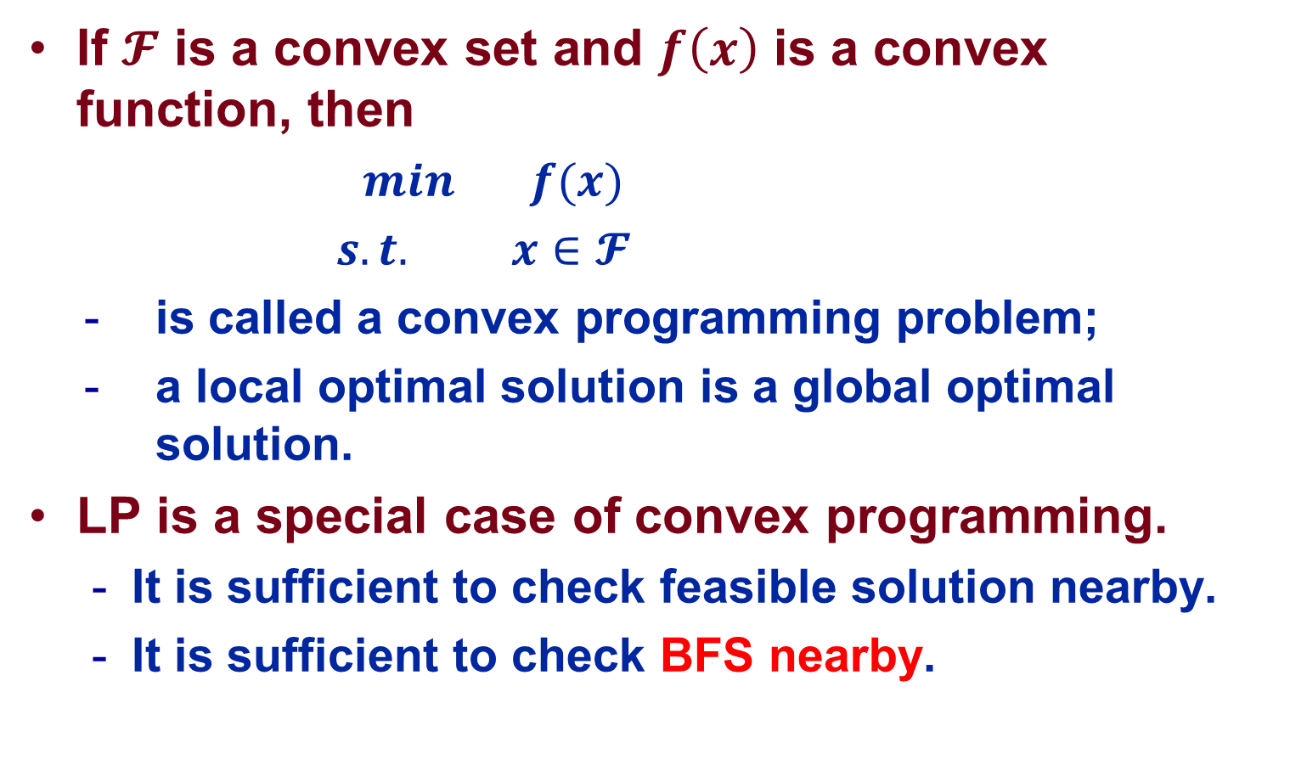
A General Principle
If $𝓕$ is a convex set and $f\left(x\right)$ is a convex function, then
  $min f(x)$
  $s.t. x∈𝓕$
  is called a convex programming problem;
  a local optimal solution is a global optimal solution.
LP is a special case of convex programming.
  It is sufficient to check feasible solution nearby.
  It is sufficient to check BFS nearby.

Slide 39
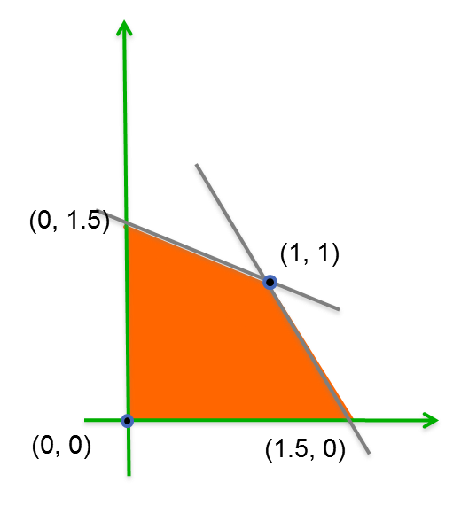
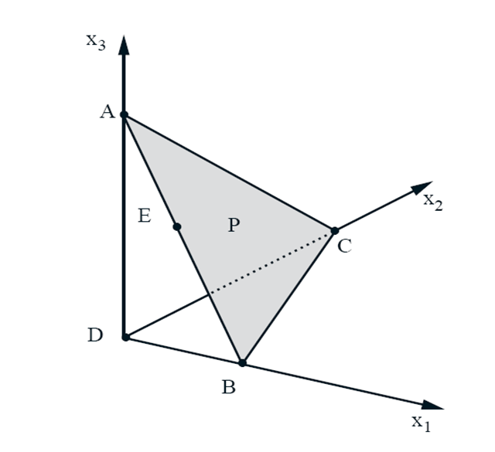
BFS nearby: Adjacent BFS
Two distinct BFSs in n-dimensional space are said to be adjacent if they share n-1 linearly independent active constraints.
  For standard form, this implies that all but one of their nonbasic variables are the same.

Slide 40

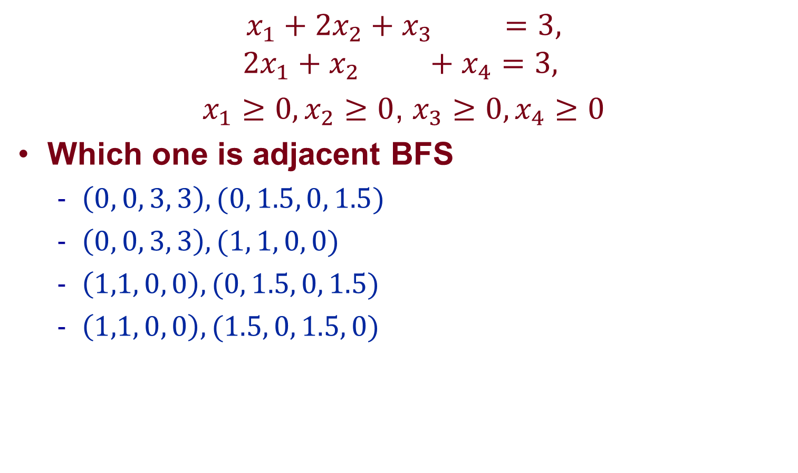
Example
$$x_{1}+{2x}_{2}+x_{3} =3,$$
$${2x}_{1}+x_{2} +x_{4}=3,$$
$x_{1}≥0,x_{2}≥0$, $x_{3}≥0,x_{4}≥0$
Which one is adjacent BFS
  $\left(0, 0, 3, 3\right), (0, 1.5, 0, 1.5)$
  $\left(0, 0, 3, 3\right), (1, 1, 0, 0)$
  $\left(1,1, 0, 0\right),(0, 1.5, 0, 1.5)$
  $\left(1,1, 0, 0\right),(1.5, 0, 1.5, 0)$

Slide 41
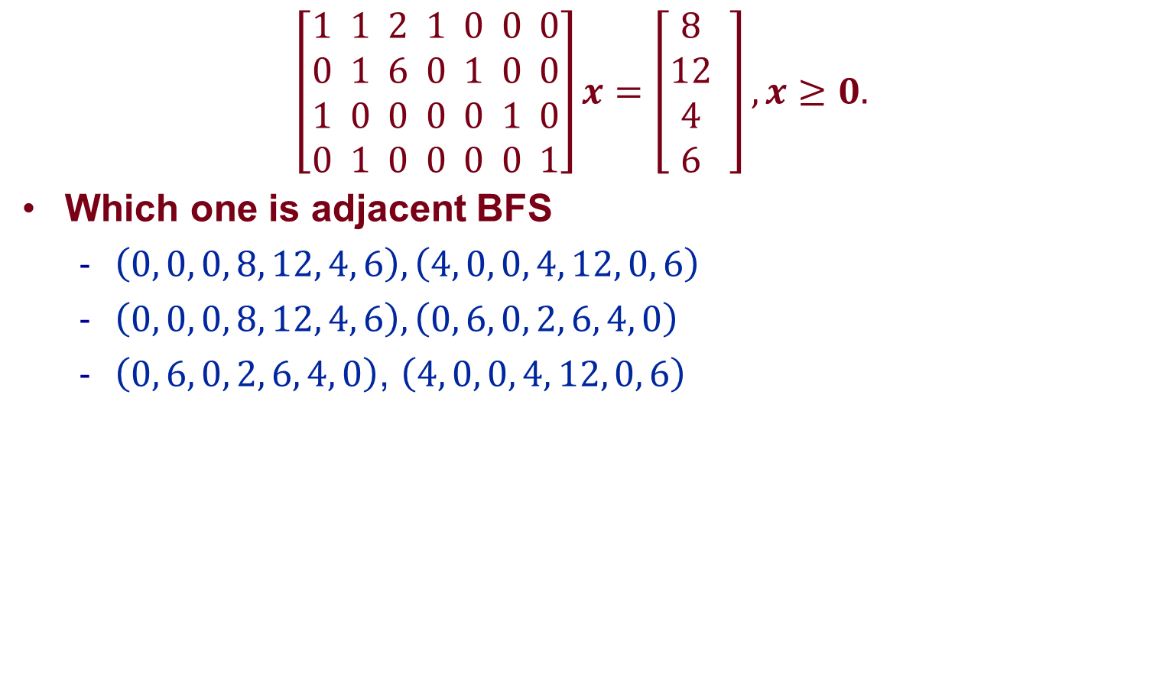
Example
$$\left[\begin{aligned}1 1 2 1 0 0 0 \\ 0 1 6 0 1 0 0 \\ 1 0 0 0 0 1 0 \\ 0 1 0 0 0 0 1\end{aligned}\right]x=\left[\begin{aligned}8 \\ 12 \\ 4 \\ 6 \end{aligned}\right],x≥0.$$
Which one is adjacent BFS
  $\left(0, 0, 0, 8, 12, 4, 6\right), \left(4, 0, 0, 4, 12, 0, 6\right)$
  $\left(0, 0, 0, 8, 12, 4, 6\right), \left(0, 6, 0, 2, 6, 4, 0\right)$
  $\left(0, 6, 0, 2, 6, 4, 0\right)$, $\left(4, 0, 0, 4, 12, 0, 6\right)$

Slide 42
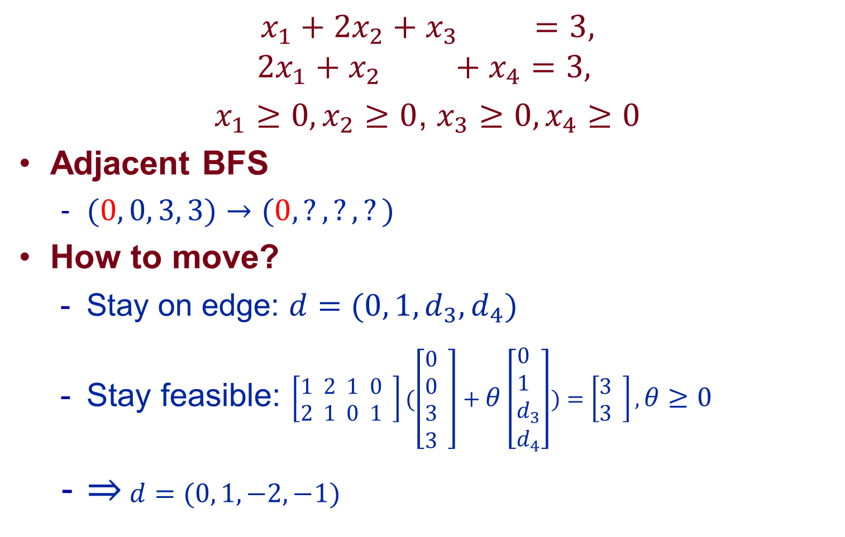

Example: Iteration 0
$$x_{1}+{2x}_{2}+x_{3} =3,$$
$${2x}_{1}+x_{2} +x_{4}=3,$$
$x_{1}≥0,x_{2}≥0$, $x_{3}≥0,x_{4}≥0$
Adjacent BFS
  $(0, 0, 3, 3)→(0, ?, ?, ?)$
How to move?
  Stay on edge: $d=(0, 1,d_{3},d_{4})$
  Stay feasible: $\left[\begin{aligned}1 2 1 0 \\ 2 1 0 1 \end{aligned}\right](\left[\begin{aligned}0 \\ 0 \\ 3 \\ 3 \end{aligned}\right]+θ\left[\begin{aligned}0 \\ 1 \\ d_{3} \\ d_{4}\end{aligned}\right])=\left[\begin{aligned}3 \\ 3 \end{aligned}\right],θ≥0$
  ⇒ $d=(0, 1,−2,−1)$
$$d$$

Slide 43
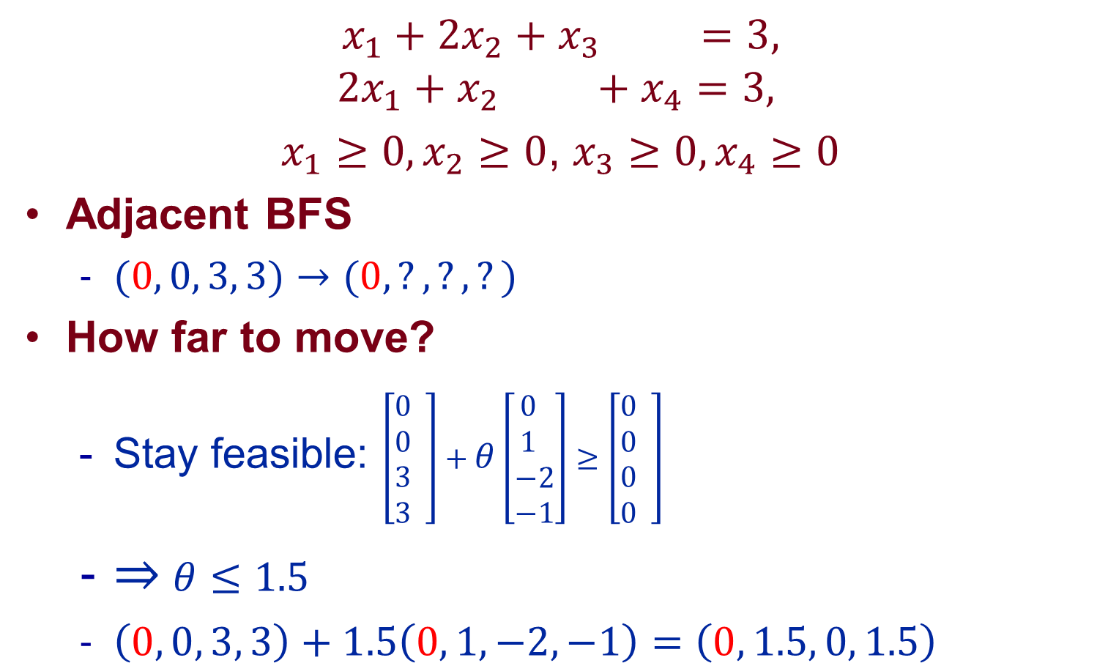

Example: Iteration 0
$$x_{1}+{2x}_{2}+x_{3} =3,$$
$${2x}_{1}+x_{2} +x_{4}=3,$$
$x_{1}≥0,x_{2}≥0$, $x_{3}≥0,x_{4}≥0$
Adjacent BFS
  $(0, 0, 3, 3)→(0, ?, ?, ?)$
How far to move?
  Stay feasible: $\left[\begin{aligned}0 \\ 0 \\ 3 \\ 3 \end{aligned}\right]+θ\left[\begin{aligned}0 \\ 1 \\ −2 \\ −1\end{aligned}\right]≥\left[\begin{aligned}0 \\ 0 \\ 0 \\ 0 \end{aligned}\right]$
  ⇒ $θ≤1.5$
  $\left(0, 0, 3, 3\right)+1.5\left(0, 1, −2, −1\right)=\left(0, 1.5, 0, 1.5\right)$
$$θd$$

Slide 44
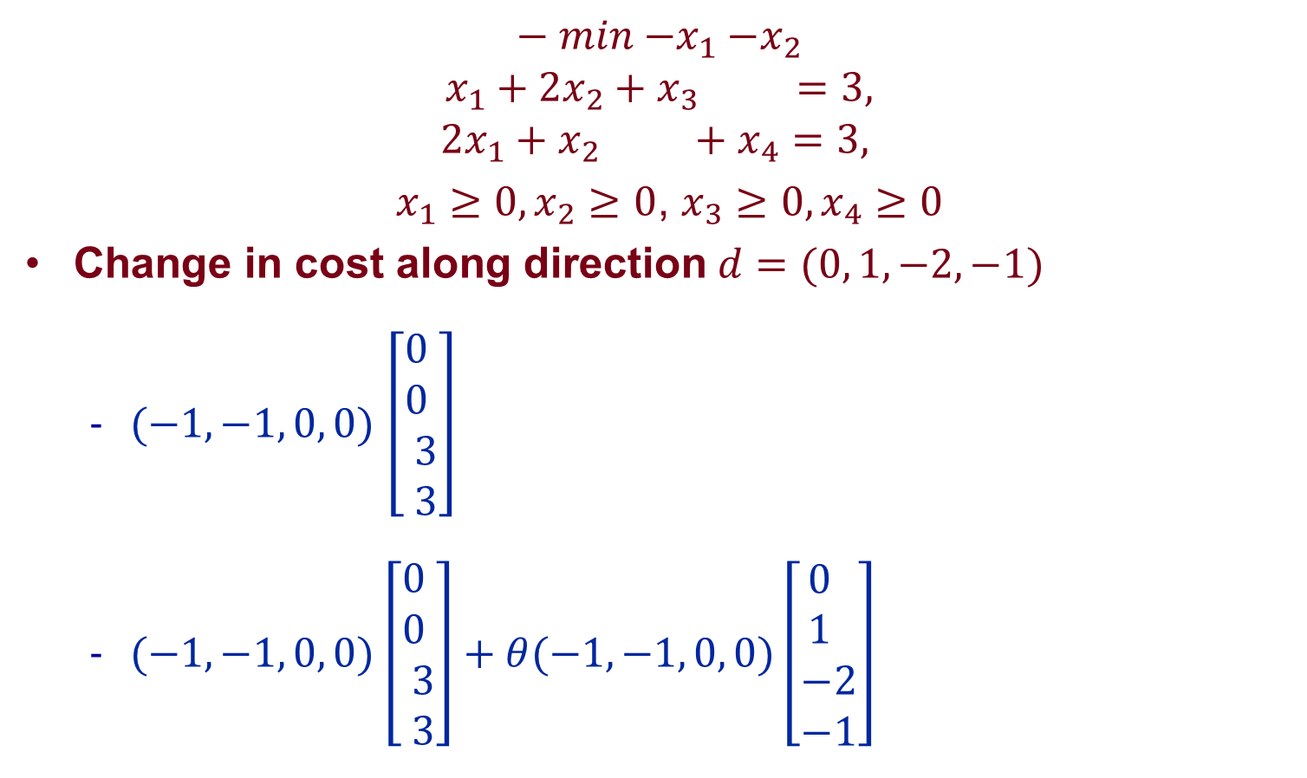

Example: Iteration 0
$$− min{−x}_{1}−x_{2}$$
$$x_{1}+{2x}_{2}+x_{3} =3,$$
$${2x}_{1}+x_{2} +x_{4}=3,$$
$x_{1}≥0,x_{2}≥0$, $x_{3}≥0,x_{4}≥0$
Change in cost along direction $d=(0, 1, −2, −1)$
  $(−1, −1, 0, 0)$ $\left[\begin{aligned}0 \\ 0 \\ 3 \\ 3\end{aligned}\right]$
  $(−1, −1, 0, 0)$ $\left[\begin{aligned}0 \\ 0 \\ 3 \\ 3\end{aligned}\right]+θ(−1, −1, 0, 0)\left[\begin{aligned}0 \\ 1 \\ −2 \\ −1\end{aligned}\right]$
$$d$$

Slide 45
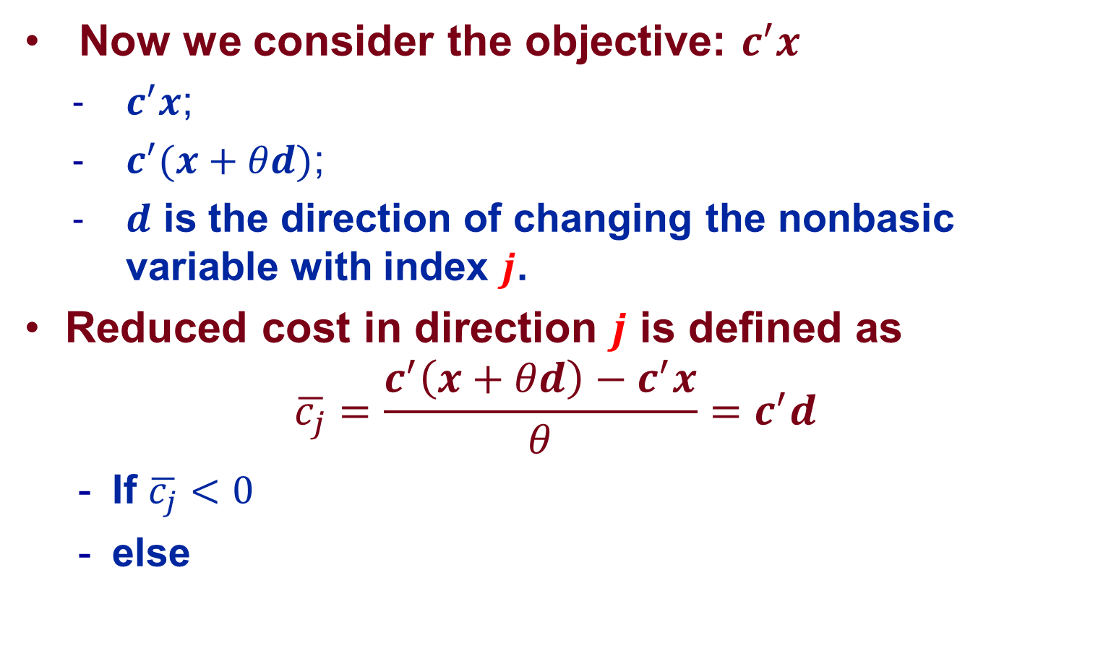
Reduced Cost
Now we consider the objective: $c^{′}x$
  $c^{′}x$;
  $c^{′}(x+θd)\text{;}$
  $d$ is the direction of changing the nonbasic variable with index $j$.
Reduced cost in direction $j$ is defined as
$$\overline{c_{j}}=\frac{c^{′}\left(x+θd\right)−c^{′}x}{θ}=c^{′}d$$
  If $\overline{c_{j}}<0$
  else

Slide 46
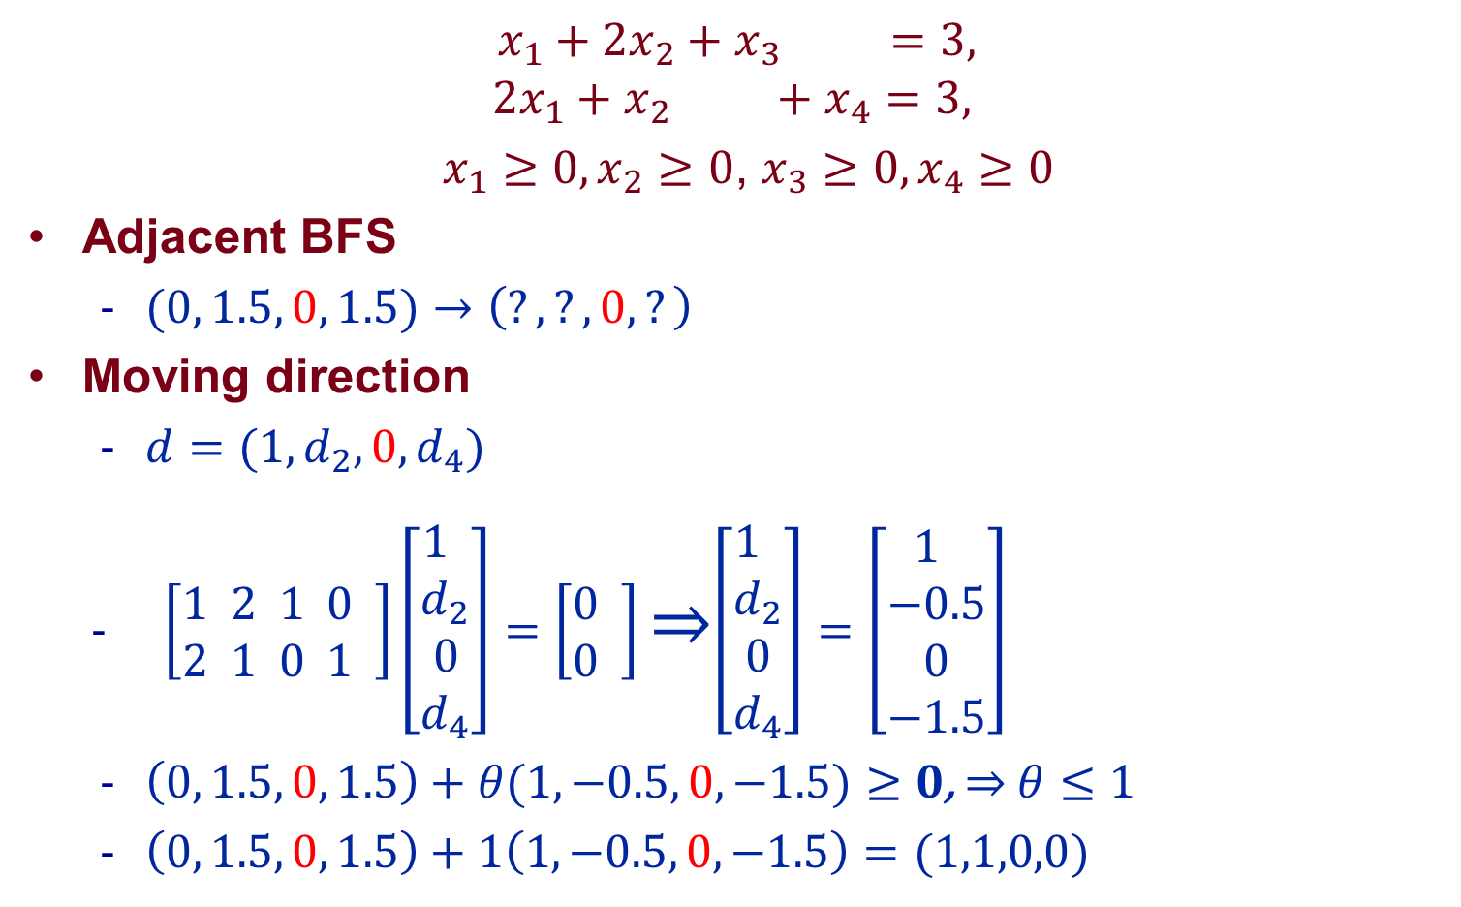
Example: Iteration 1
$$x_{1}+{2x}_{2}+x_{3} =3,$$
$${2x}_{1}+x_{2} +x_{4}=3,$$
$x_{1}≥0,x_{2}≥0$, $x_{3}≥0,x_{4}≥0$
Adjacent BFS
  $(0, 1.5, 0, 1.5)$ $→\left(?, ?,0, ?\right)$
Moving direction
  $d=(1,d_{2},0,d_{4})$
  $\left[\begin{aligned}1 2 1 0 \\ 2 1 0 1 \end{aligned}\right]\left[\begin{aligned}1 \\ d_{2} \\ 0 \\ d_{4}\end{aligned}\right]=\left[\begin{aligned}0 \\ 0 \end{aligned}\right]$ ⇒$\left[\begin{aligned}1 \\ d_{2} \\ 0 \\ d_{4}\end{aligned}\right]=\left[\begin{aligned}1 \\ −0.5 \\ 0 \\ −1.5\end{aligned}\right]$
  $\left(0, 1.5, 0, 1.5\right)+θ(1, −0.5, 0, −1.5)≥0$, ⇒ $θ≤1$
  $\left(0, 1.5, 0, 1.5\right)+1\left(1, −0.5, 0, −1.5\right)=(1,1,0,0)$

Slide 47
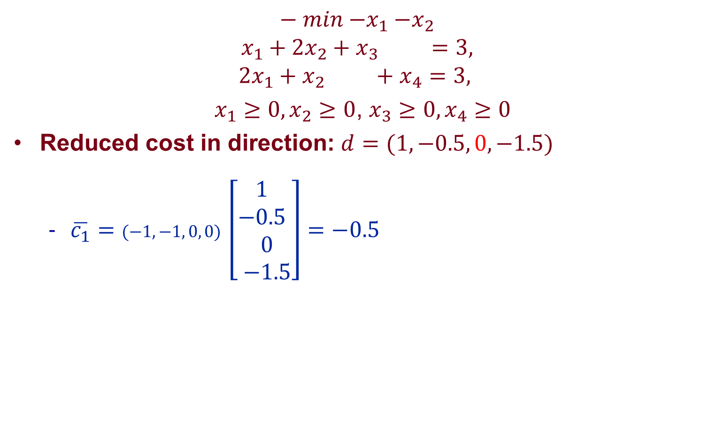

Example: Iteration 1
$$− min{−x}_{1}−x_{2}$$
$$x_{1}+{2x}_{2}+x_{3} =3,$$
$${2x}_{1}+x_{2} +x_{4}=3,$$
$x_{1}≥0,x_{2}≥0$, $x_{3}≥0,x_{4}≥0$
Reduced cost in direction: $d=(1, −0.5, 0, −1.5)$
  $\overline{c_{1}}=(−1, −1, 0, 0)$ $\left[\begin{aligned}1 \\ −0.5 \\ 0 \\ −1.5\end{aligned}\right]=−0.5$
$$d$$

Slide 48
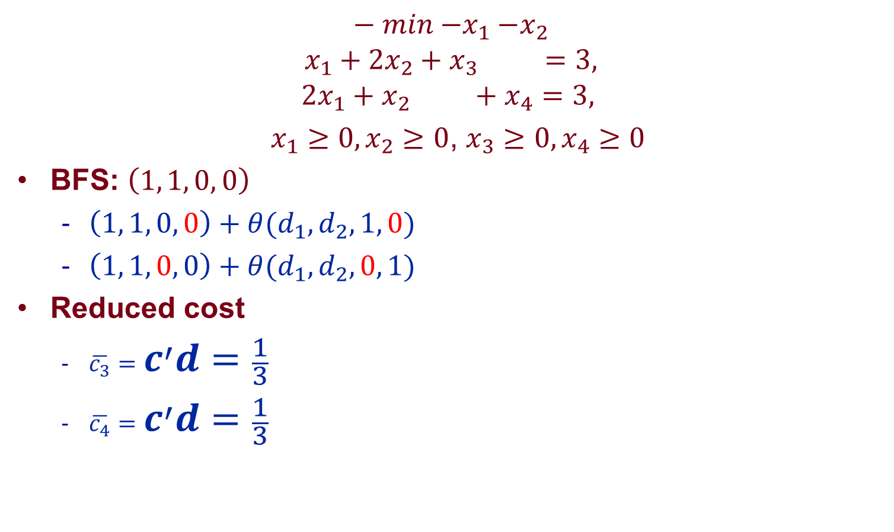
Example: Iteration 2
$$− min{−x}_{1}−x_{2}$$
$$x_{1}+{2x}_{2}+x_{3} =3,$$
$${2x}_{1}+x_{2} +x_{4}=3,$$
$x_{1}≥0,x_{2}≥0$, $x_{3}≥0,x_{4}≥0$
BFS: $\left(1, 1, 0, 0\right)$
  $\left(1, 1, 0, 0\right)+θ({d_{1},d}_{2}, 1, 0)$
  $\left(1, 1, 0, 0\right)+θ({d_{1},d}_{2}, 0, 1)$
Reduced cost
  $\overline{c_{3}}=c^{′}d=\frac{1}{3}$
  $\overline{c_{4}}=c^{′}d=\frac{1}{3}$

Slide 49
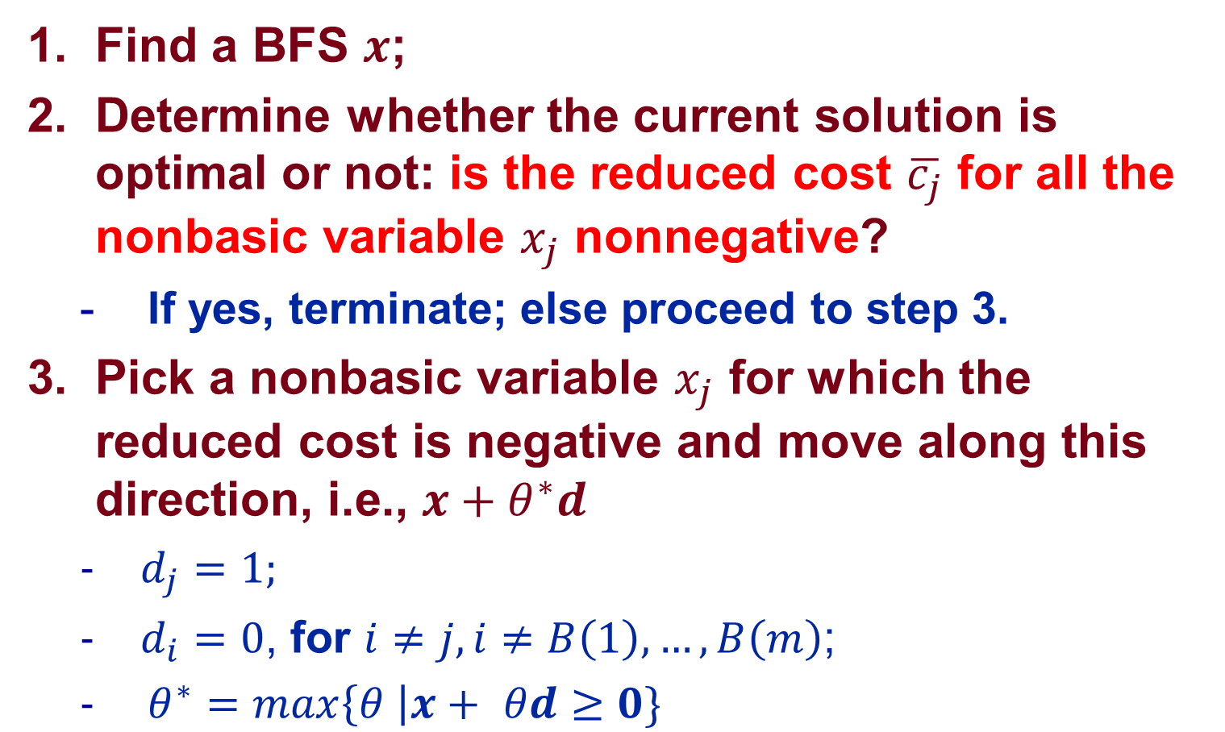
Optimality Condition and Simplex Method
Find a BFS $x$;
Determine whether the current solution is optimal or not: is the reduced cost $\overline{c_{j}}$ for all the nonbasic variable $x_{j}$ nonnegative?
  If yes, terminate; else proceed to step 3.
Pick a nonbasic variable $x_{j}$ for which the reduced cost is negative and move along this direction, i.e., $x+θ^{∗}d$
  $d_{j}=1;$
  $d_{i}=0$, for $i≠j, i≠B\left(1\right),…,B\left(m\right)$;
  $θ^{∗}=max\left\{θ \right|x+ θd≥0\}$

